Slide 1
Incident Response
Incident response is the process of responding in an organized manner to a compromise or attempted compromise of organizational information technology assets

Slide 2
Basic Definitions
Event
Adverse events
Computer Security Incident

Slide 3
Preparation
Incident response policy
Incident response plan
Related incident response procedures

Slide 4
Elements of an Incident Response Policy
Statement of management support and alignment
Objectives of the policy
Scope and limitations
Definitions of terms
Roles and responsibilities
Prioritization of risk when discovered

Slide 5
Elements of an Incident Response Policy
Metrics and performance measures
Communications planning
Mandatory adherence
Policy compliance

Slide 6
Incident Response Plan
May contain several procedures and standards related to incident response
Greater specificity
Maturation of the incident response process
How the incident response process fits

Slide 7
Incident Response Tools
Specific software may be needed for incident-handling activities such as forensics analysis

Slide 8
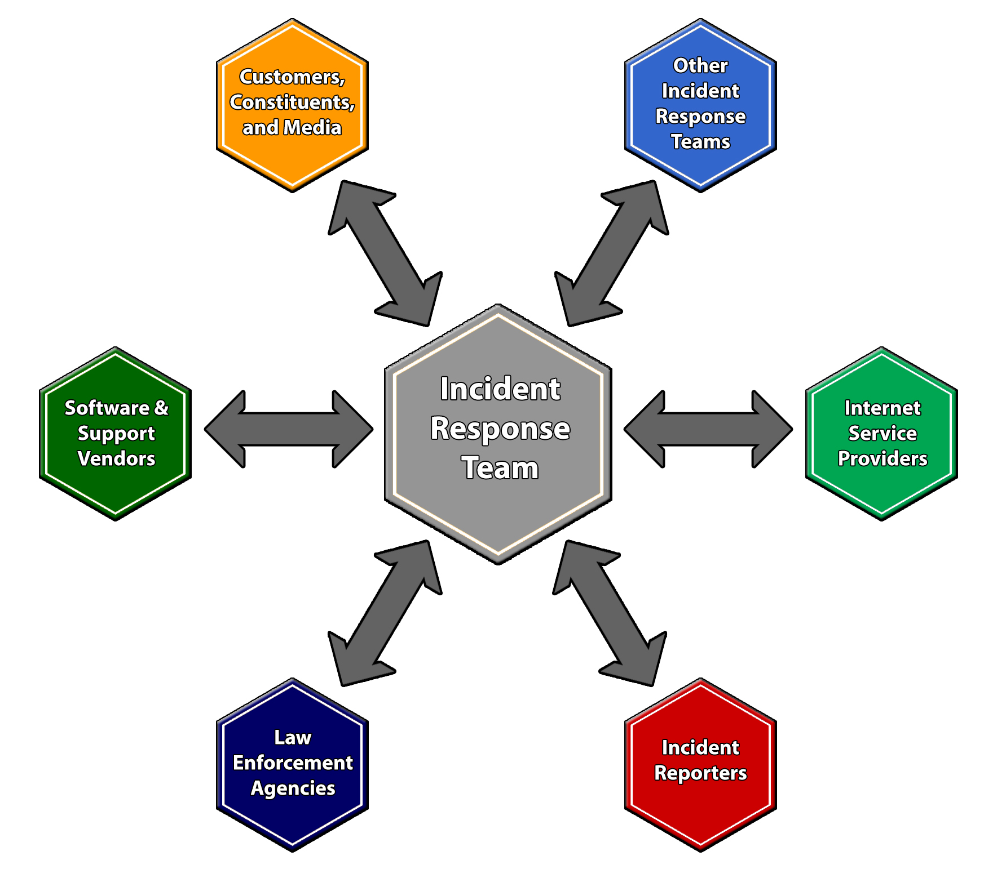
Communication Planning

Slide 9
Communication with Law Enforcement
Law enforcement reporting will vary by country, state, economy, and jurisdiction
Forensics policy, standards, and procedures should contain requirements as noted by the law enforcement partner

Slide 10
Media
All members of the incident response process should be aware of how to interact with the media
Provide accurate and timely updates to the media

Slide 11
The Incident Response Team
Virtual teams: All members have other regular duties
Some organizations have permanent team members
Hybrid: Certain permanent core members and others called up as necessary
Centralized vs. Decentralized

Slide 12
Team Conditions that Support Success
Budget enough funding
Give opportunities to perform other tasks
Consider rotating staff members
Maintain sufficient staffing
Create a mentoring program
Develop incident handling scenarios
Focus on service delivery to the organization

Slide 13
Other Considerations
Contact information
On-call information for other teams
Issue tracking system
Smartphones
Encryption software
War room
Secure storage facilities
Incident analysis

Slide 14
Other Considerations
Digital forensic workstations
Laptops
Spare equipment
Blank removable media
Portable printer
Packet sniffers and protocol analyzers
Digital forensic software
Removable media

Slide 15
Other Considerations
Evidence gathering accessories
Port lines
Documentation
Network diagrams
Current baselines
Cryptographic hashes
Access to images of clean OS and application installations

Slide 16
Detection and Analysis
Events may have a negative impact, they will not necessarily be classified as security incidents
Indicator
An event that means an incident is actually occurring or has occurred
Precursor
An event that may signal an incident in the future

Slide 17
Common Sources of Precursors and Indicators
NIST SP 800-62 Rev2 provides “Common Sources of Precursors and Indicators”

Slide 18
Types of Intrusion Systems
Network-based intrusion systems
Host-based intrusion systems

Slide 19
Intrusion Detection Techniques
Signature- or pattern-matching systems
Protocol-anomaly-based systems
Statistical-anomaly-based systems

Slide 20
False Positives and False Negatives
False positives occur when the IDS or IPS identifies something as an attack, but it is in fact normal traffic
False negatives occur when it failed to interpret something as an attack when it should have

Slide 21
Anti-Malware Systems
To remain effective, anti-malware solutions:
Require continual updates
Must be monitored to ensure they are still active and effective

Slide 22
Security Information Event Management (SIEM)
Provide a common platform for log collection, collation, and analysis in real time
Historical reporting capability

Slide 23
Incident Analysis
Incident analysis focuses on understanding what constitutes an incident in the organization instead of drive-by scans, abnormal behavior, or new system configurations

Slide 24
Records
The current status of the incident
Summary of the incident
Indicators related to the incident
Other incidents related to this incident
Actions taken by all incident handlers
Chain of custody, if applicable

Slide 25
Records
Impact assessments related to the incident
Contact information for other involved parties
A list of evidence
Comments from incident handlers
Next steps to be taken

Slide 26
Response
When an incident is detected, a containment strategy must be decided
Containment may include:
Disconnecting devices from the network
Shutting systems down
Redirecting traffic

Slide 27
Containment Strategy Considerations
Need to preserve forensic evidence for possible legal action
Availability of services the affected component provides
Potential damage leaving the affected component in place may cause
Time required for the containment strategy to be effective
Resources required to contain the affected component

Slide 28
Delaying Containment
There may be legal implications if the organization knows about the compromised system and then the compromised system is used to attack another system

Slide 29
Triage
An analysis of the incident must be performed to determine the overall impact
The assessed impact level of the incident dictate the actions that should be taken

Slide 30
Common Containment Activities
Backing up the affected system
Disconnecting the affected system
Changing system, application, and user passwords
Analyzing network traffic
Modifying firewall rules
Reviewing system, application, and security logs

Slide 31
Post-Incident Activity
A post-incident report should document the security incident and all recovery activities
Update incident response policy and procedures based on lessons learned

Slide 32
Forensics Investigations
Identifying evidence
Collecting or acquiring evidence
Examining or analyzing the evidence
Presentation of findings

Slide 33
Criminal Behavior
Behavior is intentional and serves to fulfill some purpose
Computer criminals have specific MOs and leave behind signature behaviors

Slide 34
General Guidelines
All of the general forensic and procedural principles must be applied
Actions taken should not change evidence
Train people who access original digital evidence
All activity relating to digital evidence must be fully documented, preserved, and available for review
Individual is responsible for all actions taken with respect to digital evidence while it is in his possession

Slide 35
Documentation
What is the evidence?
How was the evidence obtained?
When was the evidence obtained?
Who obtained the evidence?
Who has handled the evidence since it was obtained?
Why was the evidence handled by anyone who handled it after it was obtained?
Where has the evidence traveled since it was obtained?

Slide 36
Five Rules of Evidence
Be authentic
Be accurate
Be complete
Be convincing
Be admissible

Slide 37
Types of Analysis
Media
Network
Software
Author Identification
Content Analysis
Context Analysis
Hardware/Embedded Device

Slide 38
Author Identification
Author identification involves attempts to determine who created or authored the software/program in question
The code is examined for clues to:
Programming style
Program language
Development toolkits used
Embedded comments and addresses

Slide 39
NIST Recommendations
No actions performed by investigators should change data
Individuals accessing original data must be competent
An audit trail must be created
The person in charge of the investigation has overall responsibility
Upon seizing digital evidence, actions taken should not change that evidence

Slide 40
NIST Recommendations
No actions performed by investigators should change data
Individuals accessing original data must be competent
Create an audit trail
The person in charge of the investigation has overall responsibility
Do not change seized digital evidence

Slide 41
NIST Recommendations
Individuals who access original digital evidence, must be forensically competent
Document all activity relating to the seizure, access, storage, or transfer of digital evidence
An individual is responsible for all actions taken while digital evidence is in his/her possession
Any agency that is responsible for seizing, accessing, storing, or transferring digital evidence is responsible for compliance

Slide 42
Emergency Response Plans and Procedures
Have plans to recover and restore operations
Key personnel must receive training
Plans must be tested to ensure effective execution
Plans must be constantly reviewed and updated

Slide 43

Comparing BCP and DRP
Focuses on the continuity and recovery of critical business functions
Focused on recovery of information technology infrastructure, applications, communications equipment, and data after a disaster

Slide 44
Maximum Tolerable Downtime (MTD)
Maximum amount of time that a business function can be unavailable before the organization is harmed to a degree that puts the survivability of the organization at risk

Slide 45
Recovery Time Objective (RTO)
The period of time within which a business function or information system must be restored after a disruption

Slide 46
Recovery Point Objective (RPO)
The point in time to which data could be restored in the event of a business continuity disruption

Slide 47
Business Impact Analysis (BIA)
Assesses impacts to an organization that would result from a business disruption
Aids in the identification of critical organizational functions
Helps determine recovery time objectives

Slide 48
Stakeholder Input
Conducting a BIA requires participation from stakeholders in all organizational business units
Direct interviews with stakeholders
BIA questionnaires
Review of organizational policies and procedures
Reviews of organizational contractual requirements

Slide 49
BIA Project Stages
Identify critical IT resources
Identify disruption impacts and allowable outage times
Develop recovery priorities

Slide 50
Disaster Recovery Planning
Focuses on the restoration of IT functions after a business disruption event
Details the steps to restore critical IT systems in the event of a disaster

Slide 51
Assets
Data
Information systems
Network devices
Telecommunications equipment
Facilities
Personnel
Cloud providers
Other assets unique to the organization

Slide 52
Cold Site
Generally preconfigured with necessary infrastructure such as electrical, water, and communications access
Does not contain any provisional equipment
Available such that equipment could be acquired and installed at the location in the event of disaster

Slide 53
Warm Site
Computer hardware and related communications and networking equipment available
Equipment has been installed and configured
Systems do not have current data
Restoration of data from backup is required
Data backups may be stored at the warm site

Slide 54
Hot Site
Redundant processing environment that closely matches the production environment
Contains all of the hardware and related communications and networking equipment
Data are maintained at the hot site
Operations transition from production site to the hot site

Slide 55
Multiple Processing Sites
Supports 100% availability because data are processed simultaneously at the alternate site
Data are constantly synchronized
Always staffed by organizational personnel
Shortest recovery time alternative

Slide 56
Types of Backups
Backup Type | Data Backed Up | Time to Complete
Full Backup | All data are copied to backup media | The full system backup takes the longest time to complete
Differential Backup | A differential backup provides a backup of files that have changed since a full backup was performed. A differential backup saves the files that are different or new since the last full backup | The differential backup takes less time than the full system backup but more time than an incremental backup
Incremental Backup | An incremental backup provides a backup of files that have changed or are new since the last incremental backup | The incremental backup is the fastest backup type to perform when compared with full and differential backups

Slide 57
Off-Site Storage
Backup tapes should be stored off-site at a secure location
Ensure that they are available for restoration should the primary facility become unavailable

Slide 58
Electronic Vaulting
Appliance sits at the source location
Collects data backups from individual systems
Transmits them to the vendor location
The backup is encrypted
Data backups may be restored from the electronic vault to the source system

Slide 59
Remote Journaling
Journals and database transaction logs are transmitted electronically to an offsite location
Transaction logs can then be applied against a copy of the database at the offsite location
The offsite copy can be restored quickly

Slide 60
Clustering
Clustering refers to a method of configuring multiple computers so that they effectively operate as a single system
Can be performed for:
High-availability
Active / Passive
Load balancing
Active / Active

Slide 61
High-Availability Clustering
Uses multiple systems to reduce the risk associated with a single point of failure
Systems may be configured in an active/passive configuration:
Primary system is the active system
Secondary system with an identical configuration operates as a passive server

Slide 62
Load-Balancing Clustering
All cluster nodes are active
Provides redundancy because multiple systems are simultaneously active
If a single system fails, the remaining systems continue to provide the service

Slide 63
RAID Levels
RAID 0 – Striped Set
RAID 1 – Data Mirroring
RAID 5 – Striped Set with Parity
RAID 10 (1+0) – Data is mirrored then striped

Slide 64
Testing and Drills
Checklist Test
Structured Walkthrough Test
Simulation Test
Parallel Test
Full Interruption Test

Slide 65
Checklist Test
Each participant reviews his or her section of the plan to validate that it still contains accurate information

Slide 66
Structured Walkthrough Test
Representatives from each business unit gather together to review the BCP
Each team presents its section of the BCP to the group
Participants validate that the plan is correct

Slide 67
Simulation Testing
More in-depth testing technique
An actual disaster situation is simulated
Participants’ responses to the simulated disaster are measured

Slide 68
Parallel Testing
Involves performing processing at an alternate site
Operational test
Generally does not include representatives from departments without direct involvement in operations
Processing at production facilities is not interrupted

Slide 69
Full Interruption Testing
Processing is performed at the alternate site
Processing is ceased at the primary facility
Highly disruptive
May result in an actual disaster

Slide 70
Plan Review and Maintenance
Review BCPs and DRPs:
On an annual basis, at a minimum
After significant changes
Ensure that the plan is continually up to date

